Slide 1



Analysis of the energy sustainability of Machine Learning algorithms
Students:
Yin Jun
Tutors:
Prof. Meo Michela
Prof. Vallero Greta
First presentation
23/10/2023

Slide 2
Step
1. Preliminary definition of scenarios of interest, KPIs, and case studies that will be used in the development of the energy assessment methodologies
2. Development of models for assessing the environmental impact of centralized AI algorithms
3. Development of models for the environmental impact of AI algorithms in distributed learning

Slide 3
Step1
Get data through various simulations to build model for calculate power consumption
Dataset: FashionMnist
Original size: 1*28*28 pixels
Device: RTX3060(maximum power 80W)
Deep Learning Models:
 | Alexnet | VGG-11 | Resnet-18 | GoogLeNet
MACs | 940.95 M | 7.58 G | 1.75 G | 1.52 G
Number of Parameters | 46.76 M | 128.81 M | 11.18 M | 5.98 M
Average energy of each round | 34430.087 J | 113015.843 J | 112909.394 J | 124845.577 J
Average time of each round | 437.3 s | 1419.5 s | 1417.9 s | 1567.8 s
Average final reached train acc | 87.92% | 97.42% | 97.43% | 81.73%
Average final reached test acc | 87.99% | 89.31% | 89.85% | 81.88%
The energy, time, final reached train acc and test acc results are the averaged valued of 10 rounds simulation
MACs(Multiply-Accumulate Operations)
The unit for measuring the computational complexity of a deep learning model
https://github.com/sovrasov/flops-counter.pytorch

Slide 4
Step1
Get data through various simulations to build model for calculate power consumption
Dataset: FashionMnist
Original size: 1*28*28 pixels
Device: RTX4090(maximum power 450W)
Deep Learning Models:
 | Alexnet | VGG-11 | Resnet-18 | GoogLeNet
MACs | 940.95 M | 7.58 G | 1.75 G | 1.52 G
Number of Parameters | 46.76 M | 128.81 M | 11.18 M | 5.98 M
Average energy of each round | 33635.658 J | 101025.244 J | 33225.415 J | 111809.926 J
Average time of each round | 180.7 s | 388.1 s | 174.6 s | 397.4 s
Average final reached train acc | 88.00% | 97.42% | 87.98% | 82.26%
Average final reached test acc | 88.23% | 89.07% | 88.04% | 81.46%
The energy, time, final reached train acc and test acc results are the averaged valued of 10 rounds simulation
MACs(Multiply-Accumulate Operations)
The unit for measuring the computational complexity of a deep learning model
https://github.com/sovrasov/flops-counter.pytorch

Slide 5
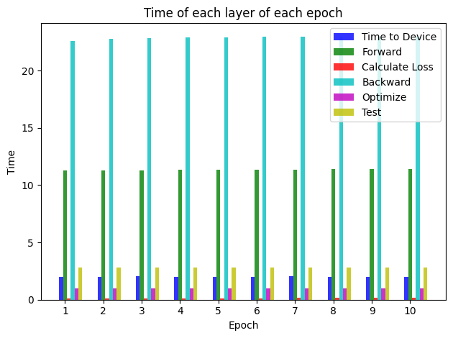
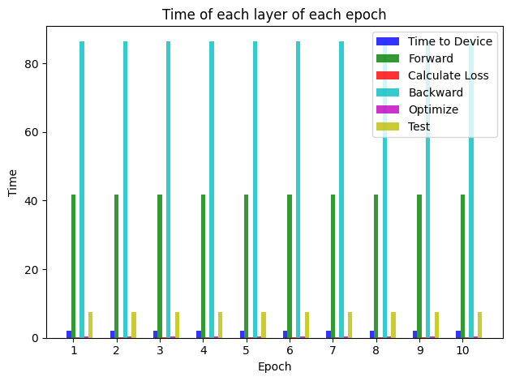
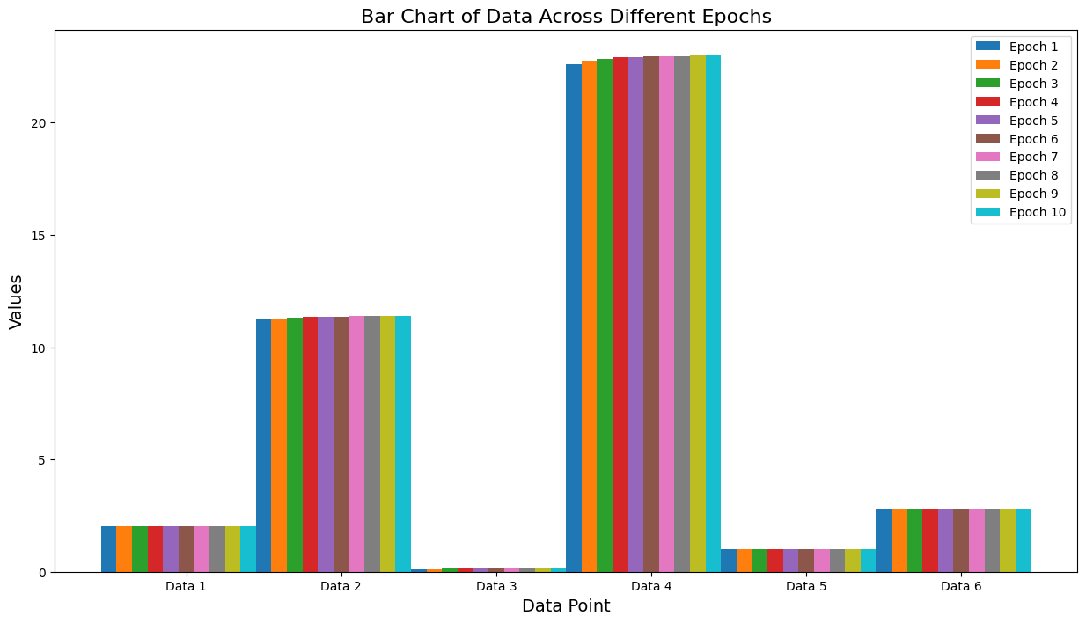
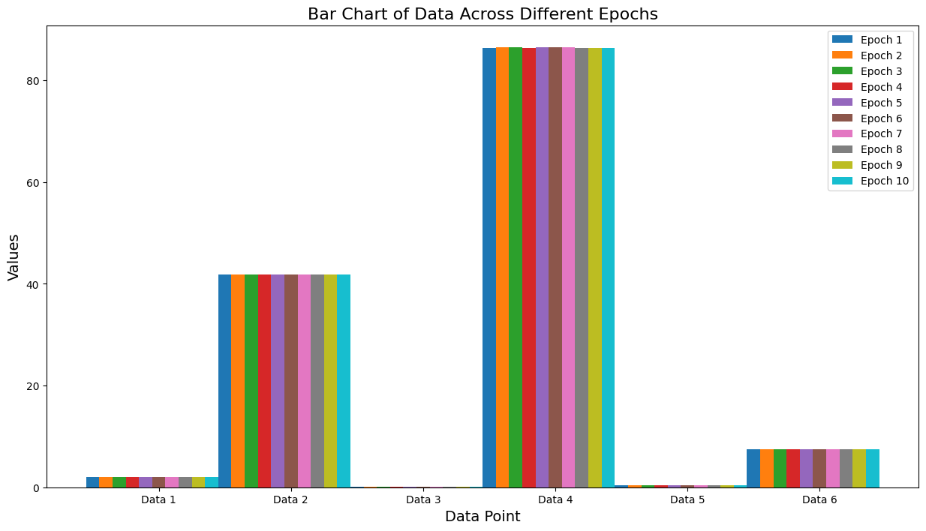

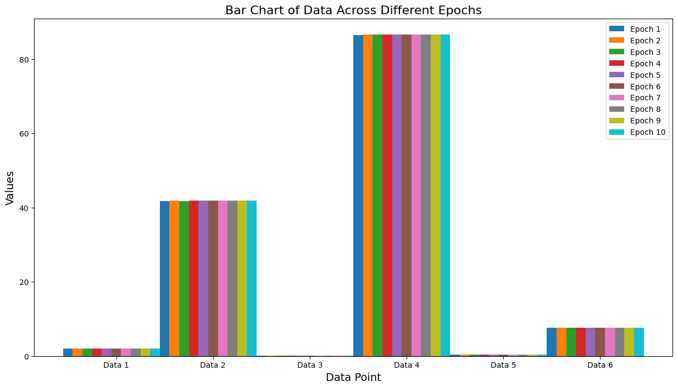
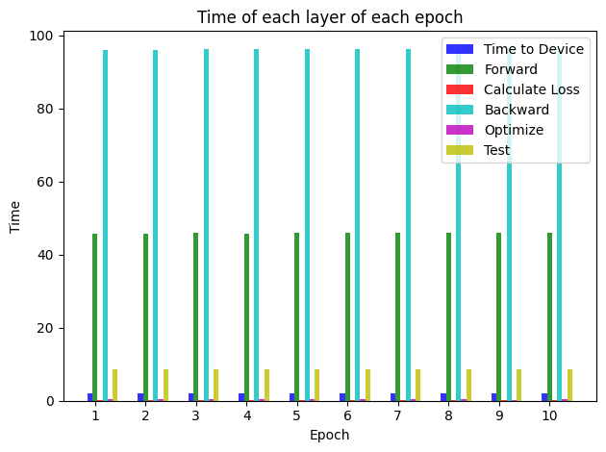
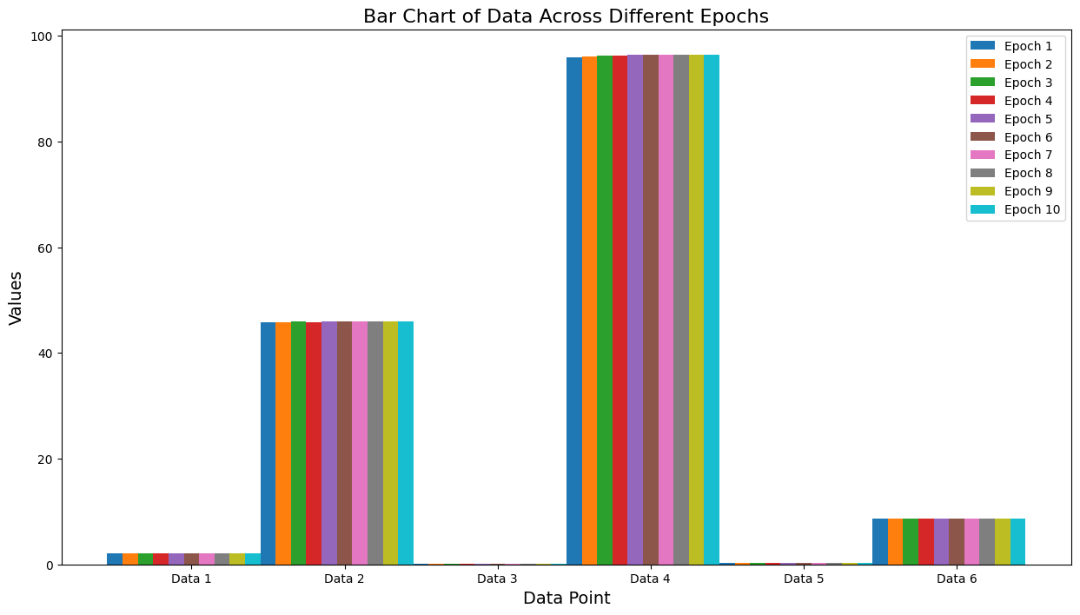
Time consumption of each part of simulation(3060)
Alexnet
Resnet-18
VGG-11
GoogLeNet

Slide 6
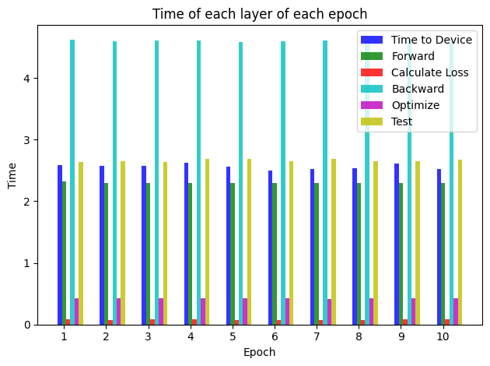
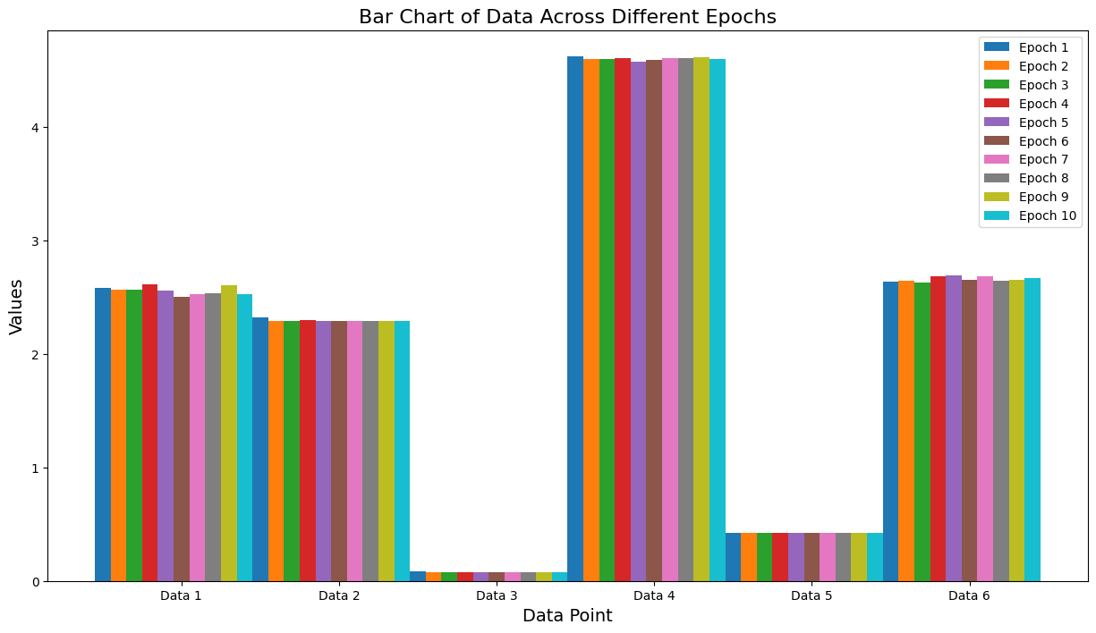

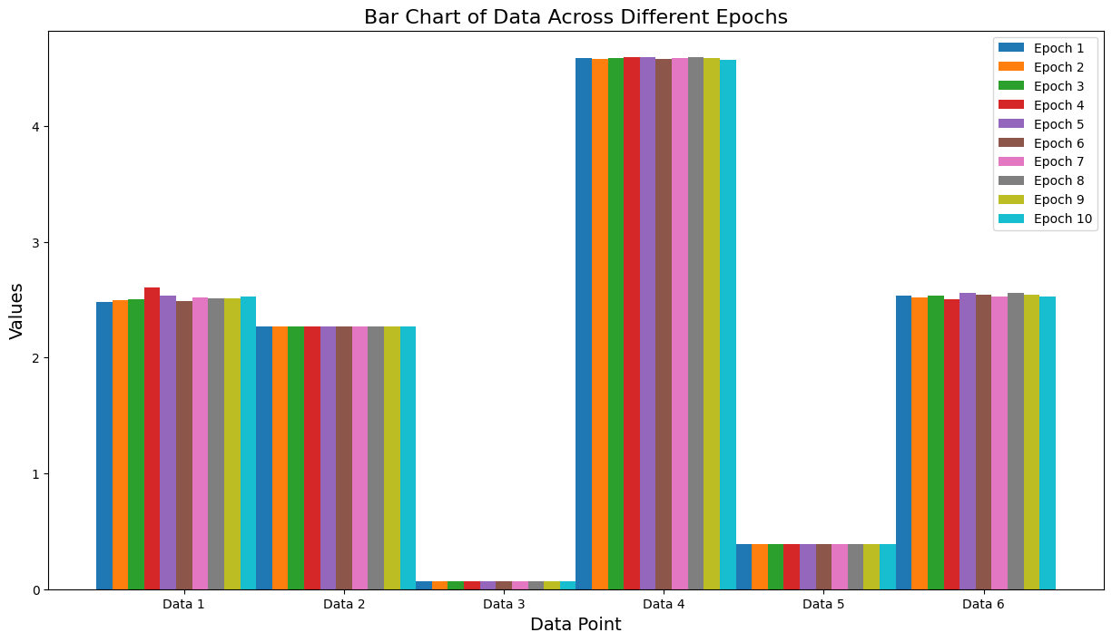
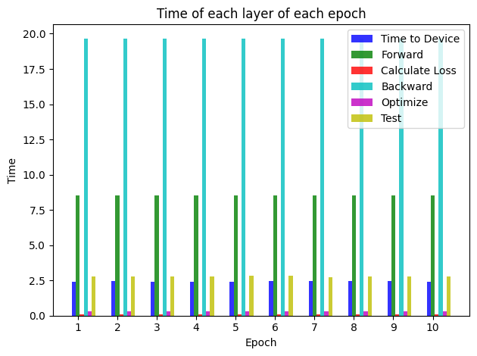

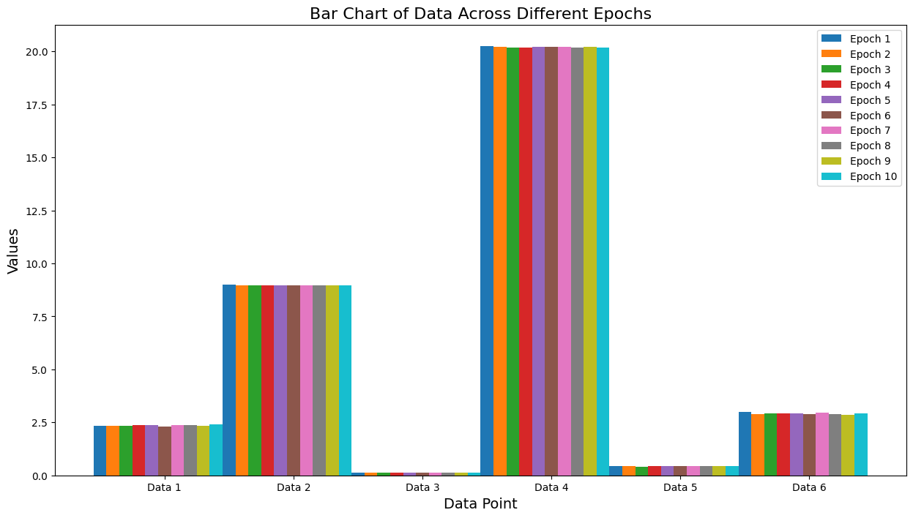
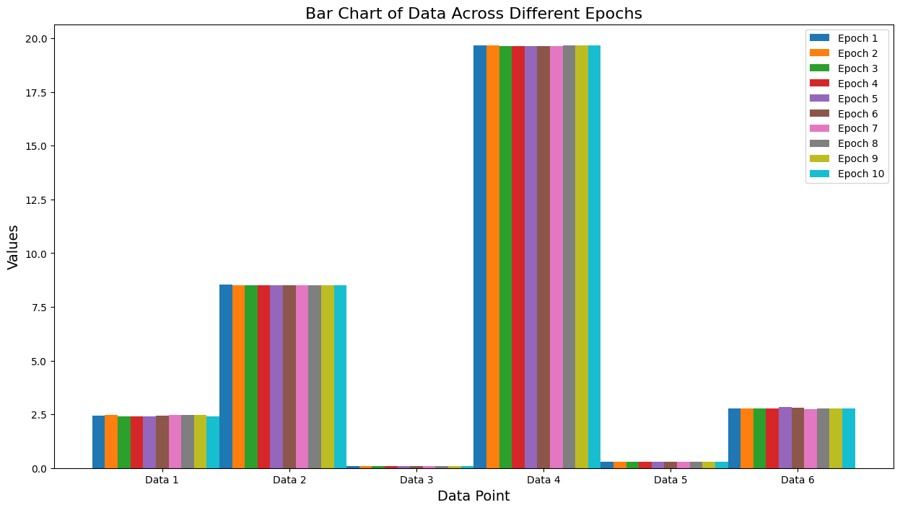
Time consumption of each part of simulation(4090)
Alexnet
Resnet-18
VGG-11
GoogLeNet

Slide 7
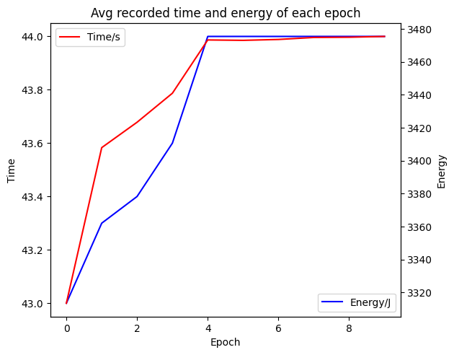
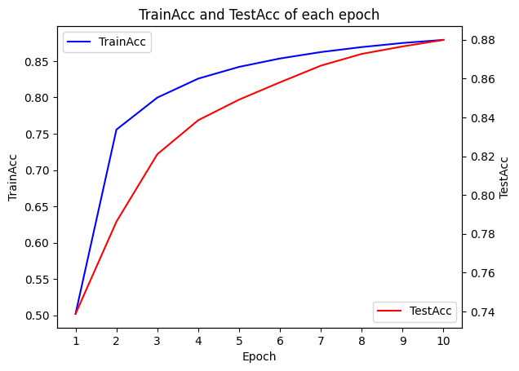
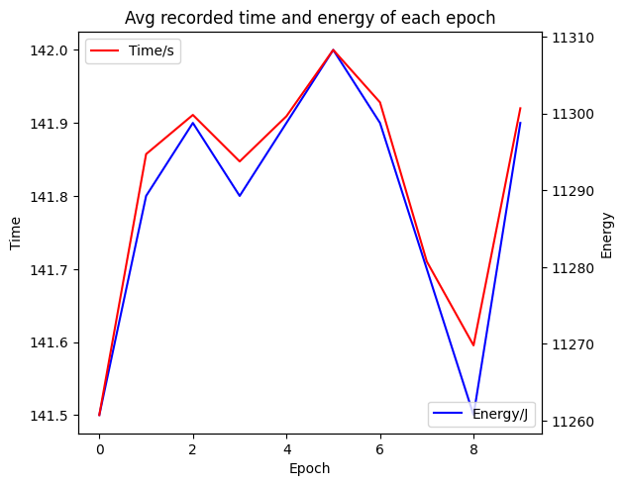
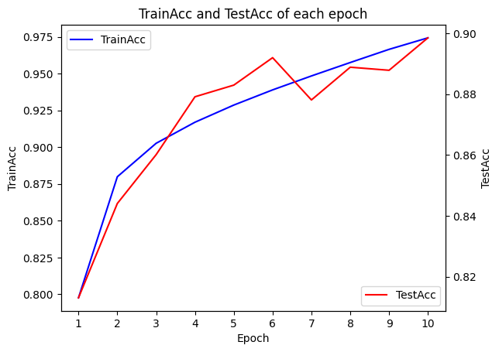
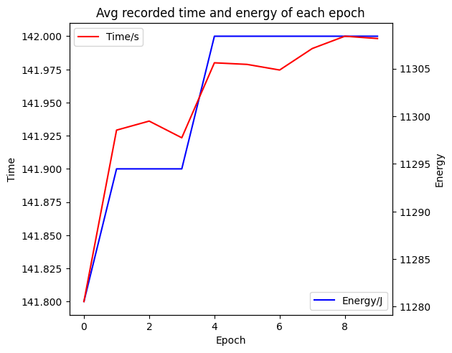
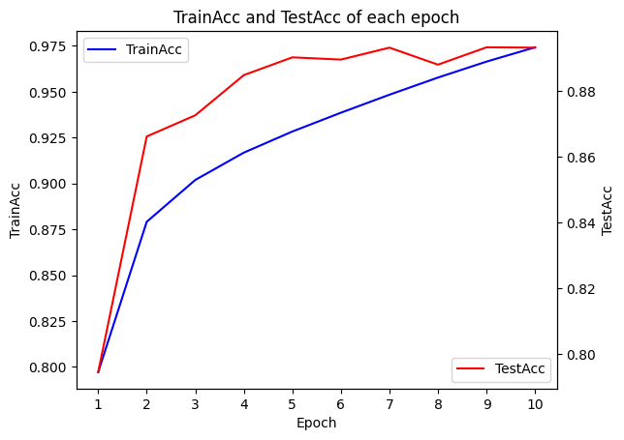
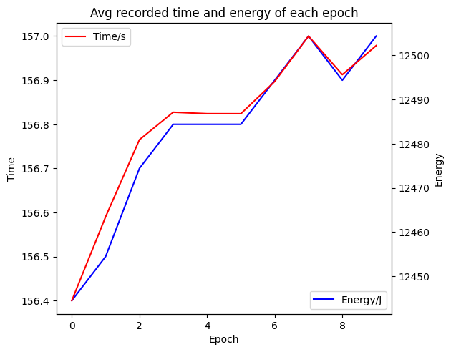
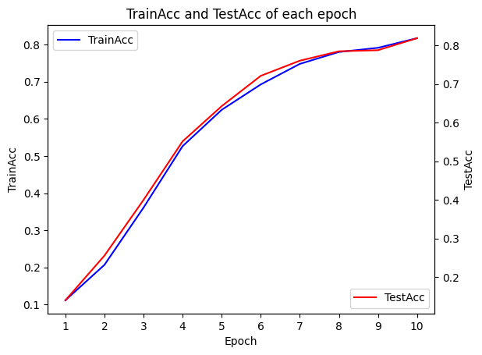
Average time & energy consumption, train & test acc(3060)
Alexnet
Resnet-18
VGG-11
GoogLeNet

Slide 8
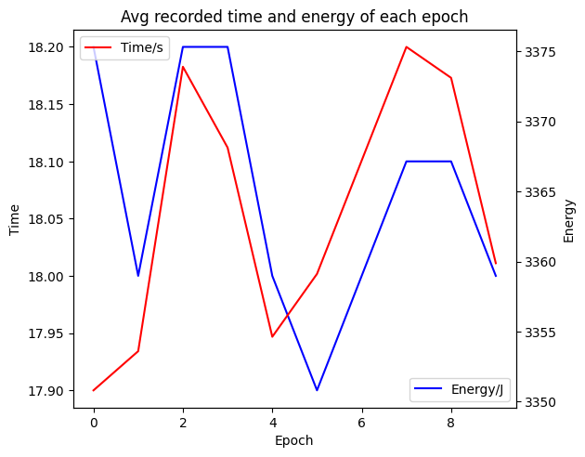

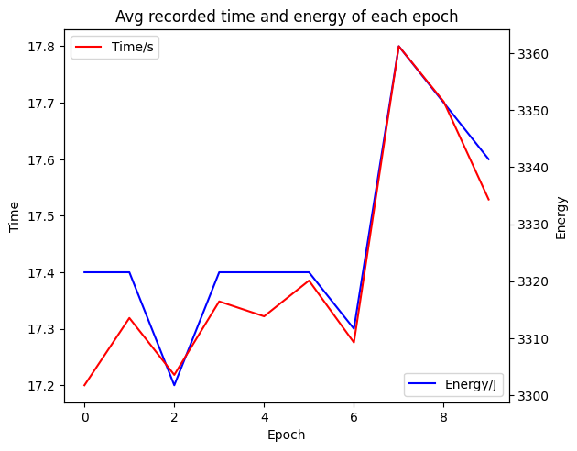
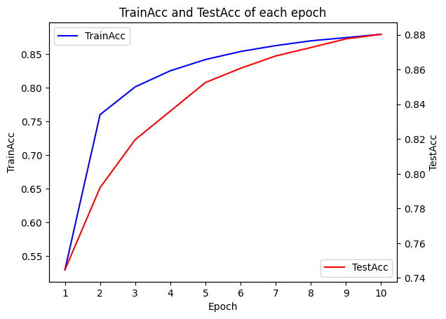
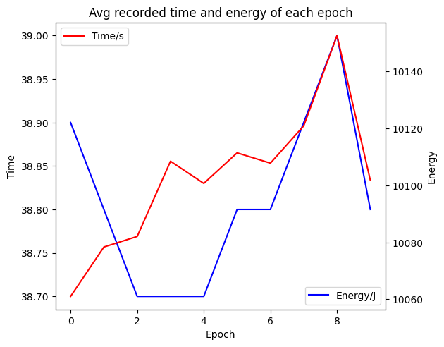
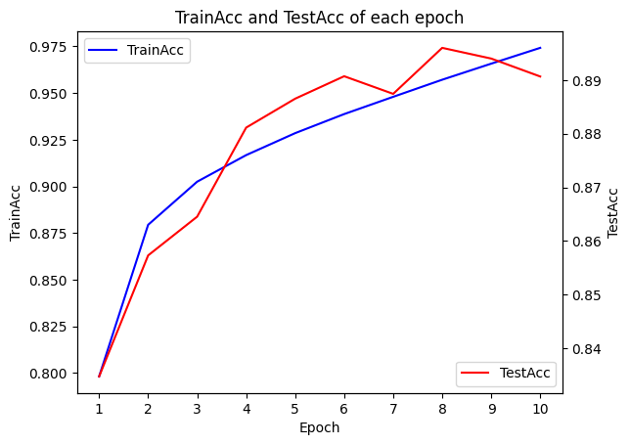
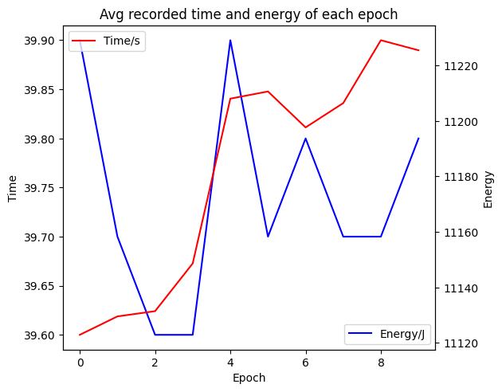
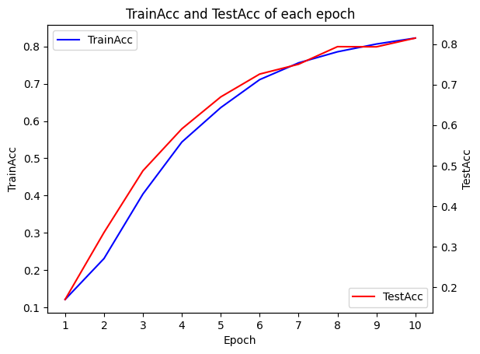
Average time & energy consumption, train & test acc(4090)
Alexnet
Resnet-18
VGG-11
GoogLeNet

Slide 9
Simulation result
For deep learning models, using synchronize can perfectly measure time consumption of each step during the training part.
All the data are using average values of 10 rounds simulation, with each round contains 10 epochs. And the average time consumption results of each epoch in different deep learning models are almost the same with a variation of less than 1 second.
During the training part, the two most time-consuming parts are the backward and the forward.
The MACs(Multiply-Accumulate Operations) can be used as a parameter to do the energy consumption prediction of a given deep learning model.
In the table presented in the first slide, the Resnet and VGG have better test accuracy than Alexnet about 2% but consume over 3 times the energy, which might be due to the dataset.
Using different GPUs can result significantly different running times, and some algorithms in different hardware may have significantly different energy consumption.
Next step:
Try to find more KPIs for building a model to calculate energy consumption
Number of Parameters
MACs
Computational parallelism
Hardware Utilization
Communication Overhead

Slide 10
Step
1. Preliminary definition of scenarios of interest, KPIs, and case studies that will be used in the development of the energy assessment methodologies
2. Development of models for assessing the environmental impact of centralized AI algorithms
3. Development of models for the environmental impact of AI algorithms in distributed learning

Slide 11
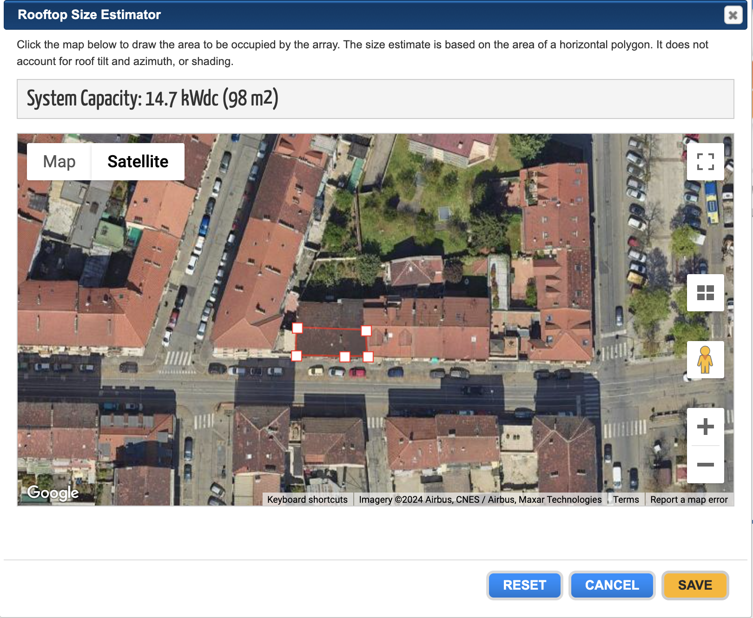
Step2
PVWatts Hourly PV Performance Data
Requested Location | turin
Location | TORINO-CASELLE, ITALY
Latitude (DD) | 45.18
Longitude (DD) | 7.65
Elevation (m) | 282
DC System Size (kW) | 14.2
Module Type | Standard
Array Type | 2-Axis Tracking
Array Tilt (deg) | 0
Array Azimuth (deg) | 180
System Losses (%) | 14.08
DC to AC Size Ratio | 1.2
Inverter Efficiency (%) | 96
Ground Coverage Ratio | NA
Albedo | From weather file
Bifacial | No (0)
Monthly Irradiance Loss (%)
 | Jan | 0
 | Feb | 0
 | Mar | 0
 | Apr | 0
 | May | 0
 | June | 0
 | July | 0
 | Aug | 0
 | Sept | 0
 | Oct | 0
 | Nov | 0
 | Dec | 0

Slide 12
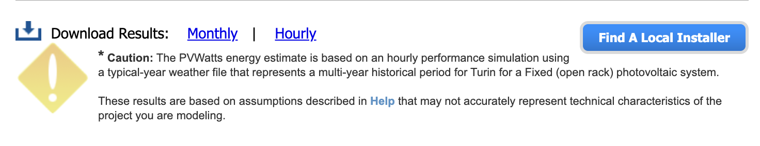
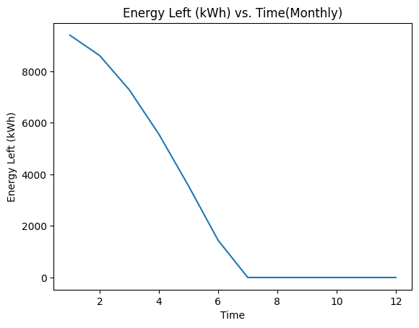
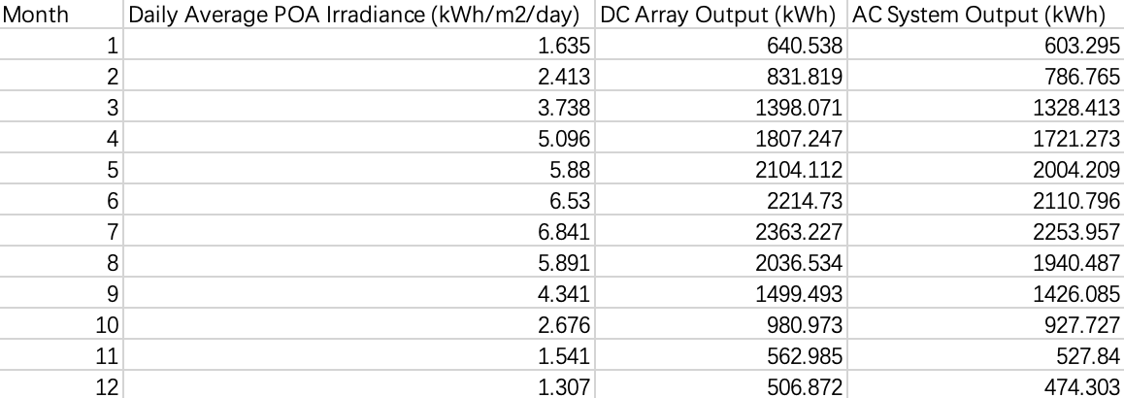
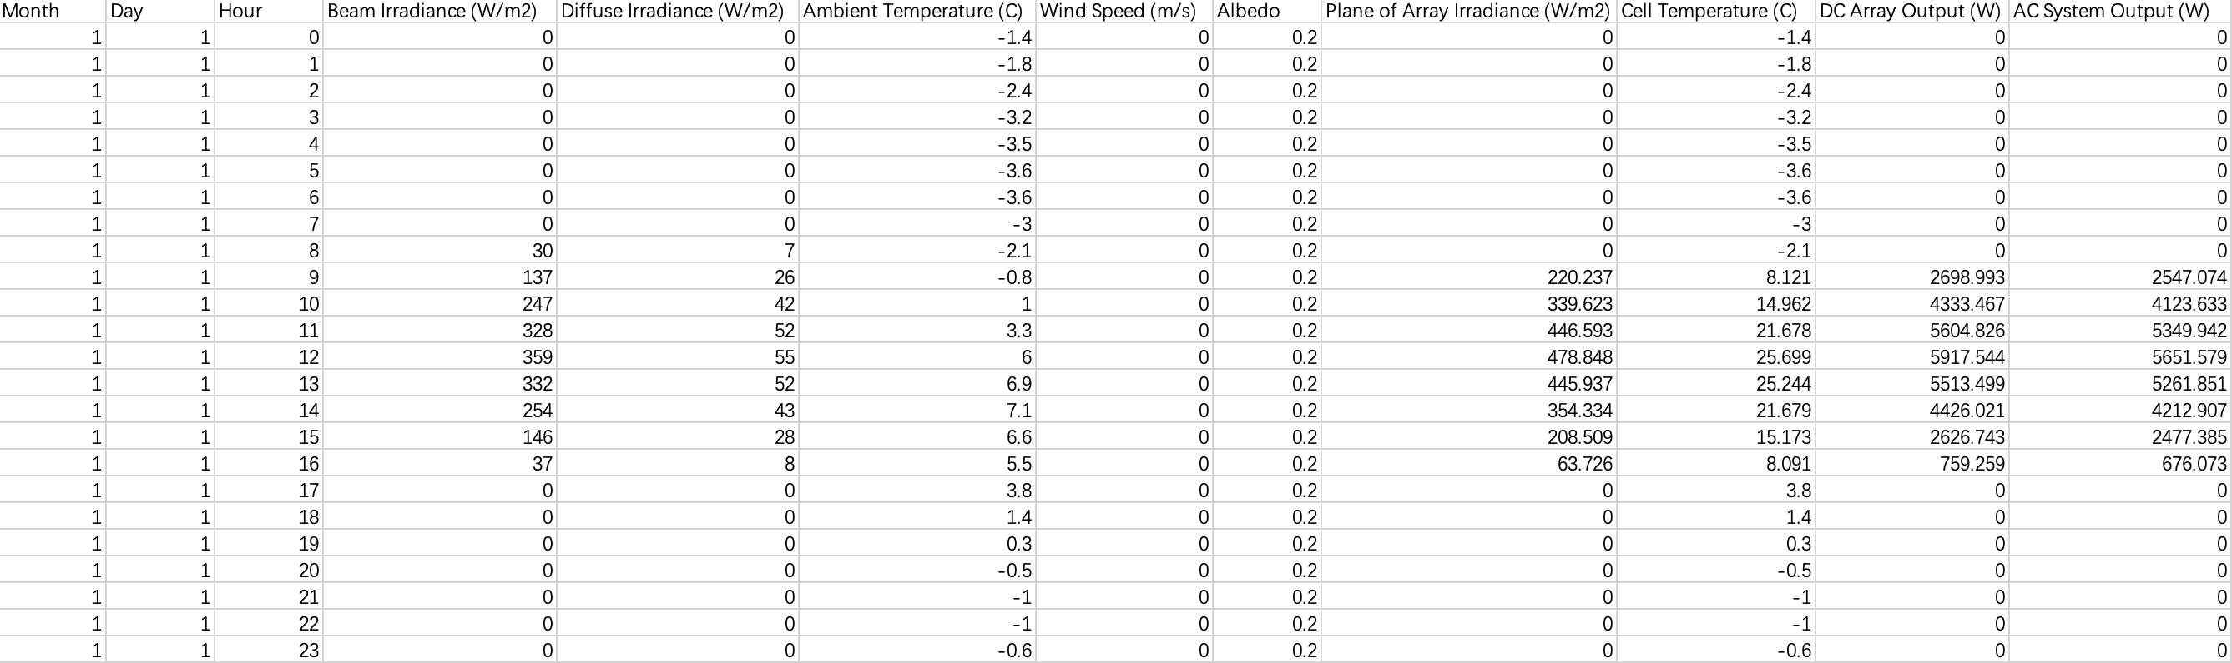
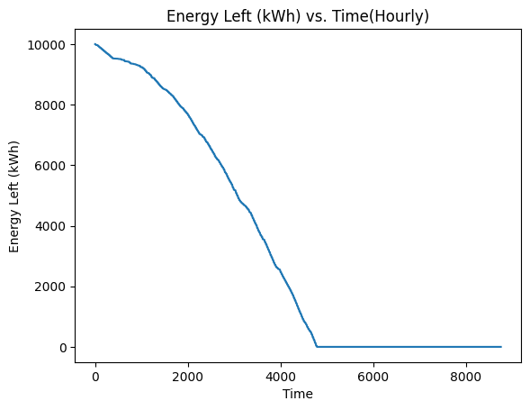
Step2
Preliminary set: energy consumption for training a model to a given accuracy is 10000kWh
Format of the monthly data
Format of the hourly data

Slide 13
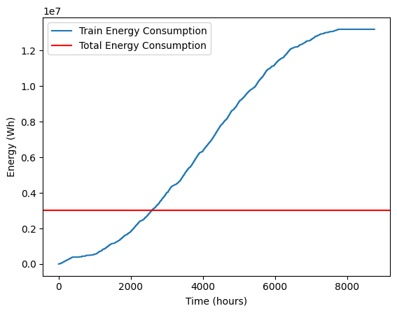
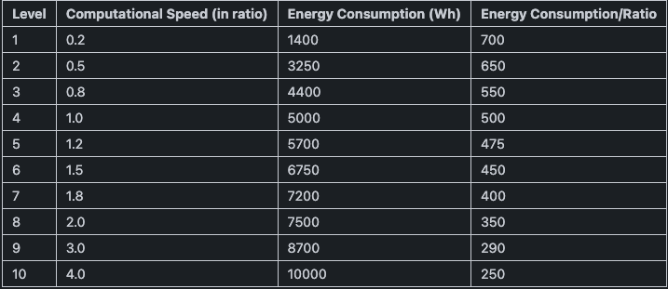
Scenario 1
Preliminary set: energy consumption for training a model to a given accuracy is 3000kWh
The power all comes from solar panels, if the generated power reaches certain level, the data center will allocate the corresponding computational speed
7765th hour
the day is: 323 the hour is: 13
the total energy consumption is: 13185.2 kWh
Notes:
1. not mix with the pue(for now)
focusing on the computation

Slide 14
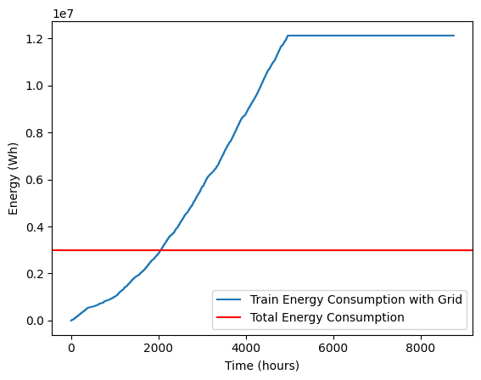
Scenario 2
Preliminary set: energy consumption for training a model to a given accuracy is 3000kWh
The power mainly comes from solar panels, if the generated power reaches certain level, the data center will allocate corresponding computational speed of the upper level by consuming power from the grid
4960th hour
the day is: 206 the hour is: 16
The total power consumed is: 12114.8 kWh
The total energy consumption from the grid is: 2848.87 kWh

Slide 15
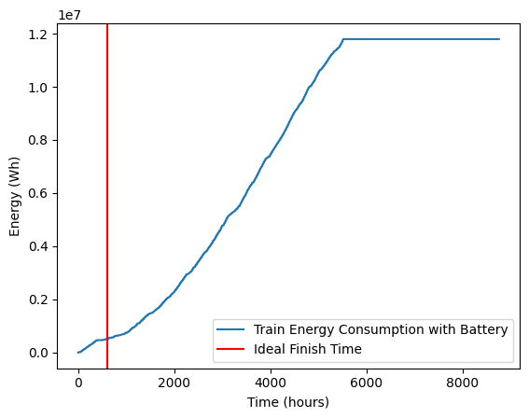
Scenario 3
Preliminary set: energy consumption for training a model to a given accuracy is 3000kWh
The power all comes from solar panels, at each time the power that cannot be consumed by the training will be save to an ideal battery with no upper limit, when the energy stored reaches to the 10000Wh, the battery will be the power supply to make the data center train the model at the speed of 4.0 mode.
4960th hour
the day is: 206 the hour is: 16
the total power consumed is: 10395.6 kWh
Notes:
check why the time is same with scenario 2
1.datacenter数据需要验证，对里面的数据的验证
2. battery部分需要加上损失，通过论文来验证一下损失大概要多少
3. case考虑到一直用到最高速度的情况下，大概需要多少电能（从电网）
4. 考虑经济效应的话，晚上去考虑训练的部分，费用花费的情况是什么样的
5. 3000kWh能够达到的准确度
6. acc & energy consumption & time & price relation
7. 目前先不考虑PUE的事情，之后再加入

Slide 16
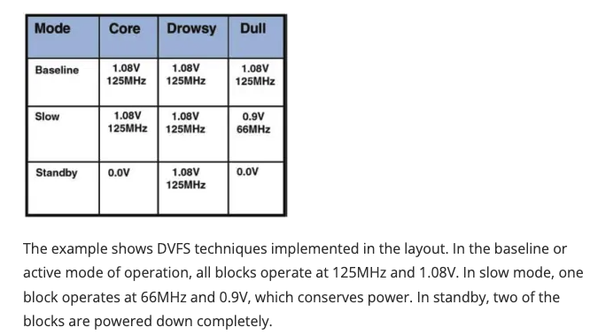
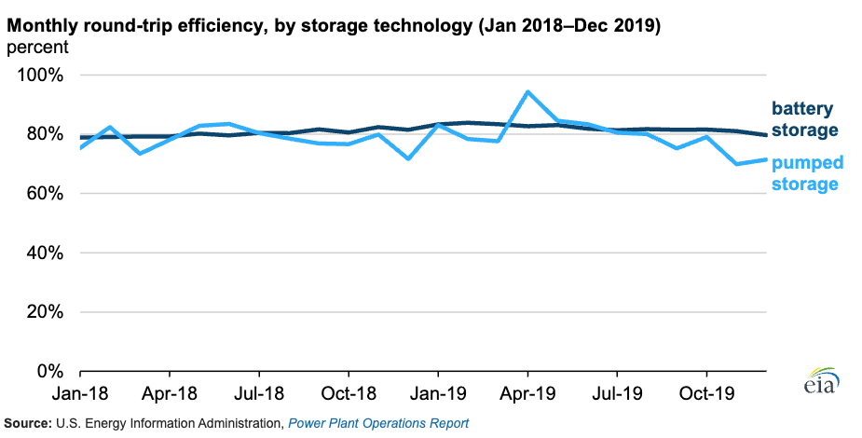
DVFS, battery round-trip efficiency
Dynamic voltage and frequency scaling (DVFS)
According to data from the U.S. Energy Information Administration (EIA), in 2019, the U.S. utility-scale battery fleet operated with an average monthly round-trip efficiency of 82%
https://www.eia.gov/todayinenergy/detail.php?id=46756
Notes:
电池大小是否会有效率上的区别

Slide 17
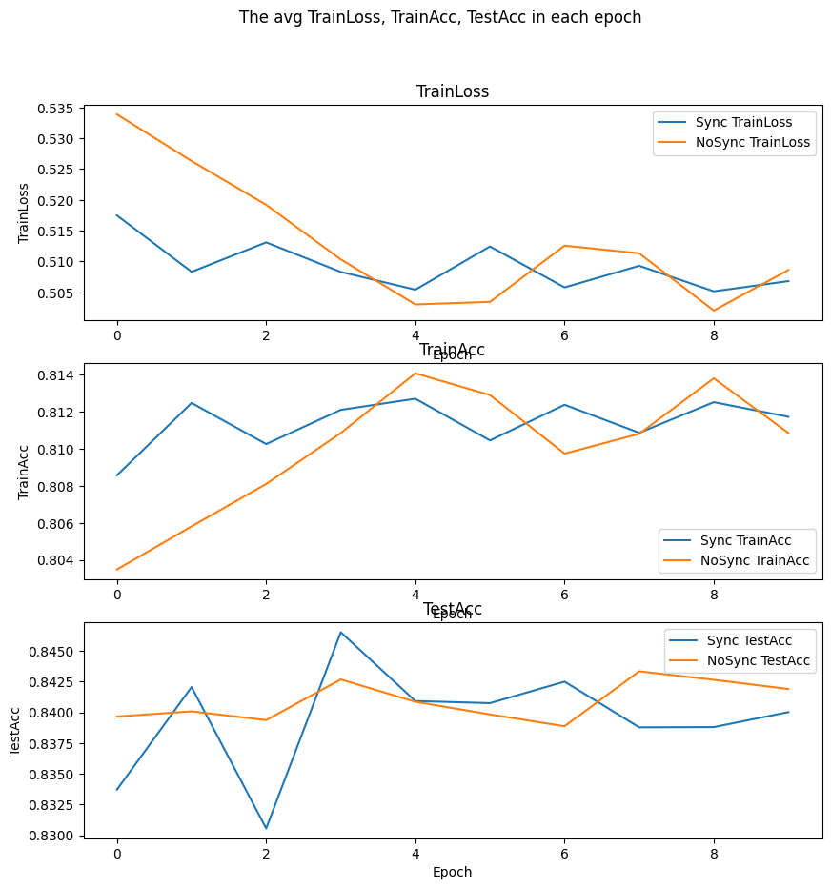
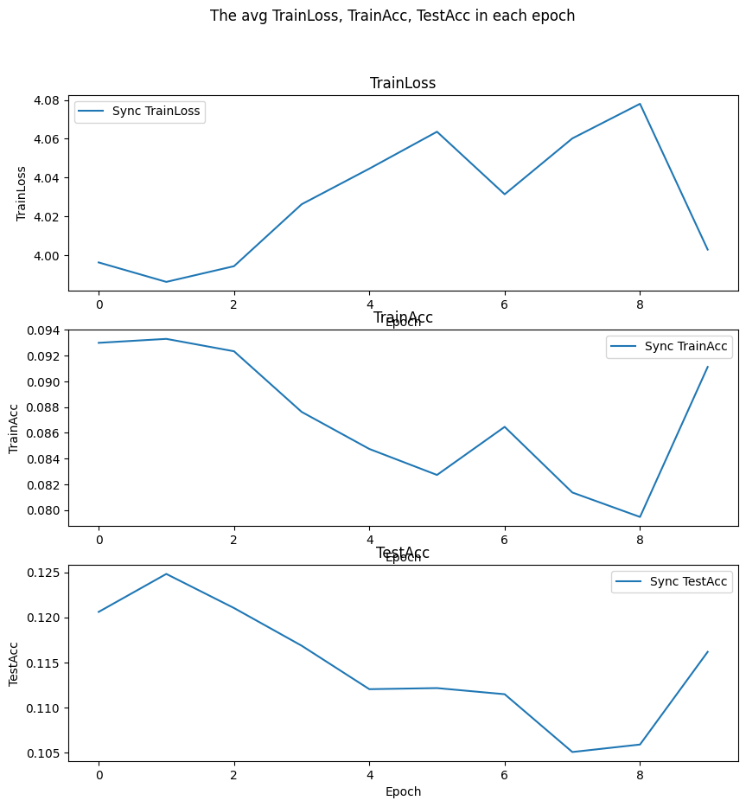
Energy consumption and acc
FashionMNIST
CIFAR100
AlexNet
AlexNet
6 Billion Parameter Transformer. We tracked the energy consumption of training a large language model comprising over 6.1 billion parameters during 8 days on 256 NVIDIA A100s. The total energy amounted to a staggering 13.8 MWh. This model was not trained to completion, but only until 13%; a full training run would take 60 days. Thus, we estimate the total energy consumption to train this model to completion would be approximately (60/8) ∗ 13.8 = 103.5 MWh, or 103,500 kWh — almost 2800 times more than training the BERT-small model!
Dodge, Jesse, Taylor Prewitt, Remi Tachet des Combes, Erika Odmark, Roy Schwartz, Emma Strubell, Alexandra Sasha Luccioni, Noah A. Smith, Nicole DeCario, and Will Buchanan. "Measuring the carbon intensity of ai in cloud instances." In Proceedings of the 2022 ACM conference on fairness, accountability, and transparency, pp. 1877-1894. 2022.
Notes:
调整模型，看看是否能到达相同的精确度
bigger dataset ， same acc
同样类型的图片（红黄绿）

Slide 18
Next step
1. Use DVFS to adjust the GPU power limit to satisfy the power generated by PV panels
2. Extra power generated by PV panels will be saved to a storage battery
3. Set a deadline of the training job, and to maximize the green energy consumption
4. Calculate the final percentage that can be saved from grid
Notes:
follow the sun——paper name
optimize the location, multiple tasks, and how to manage it

Slide 19
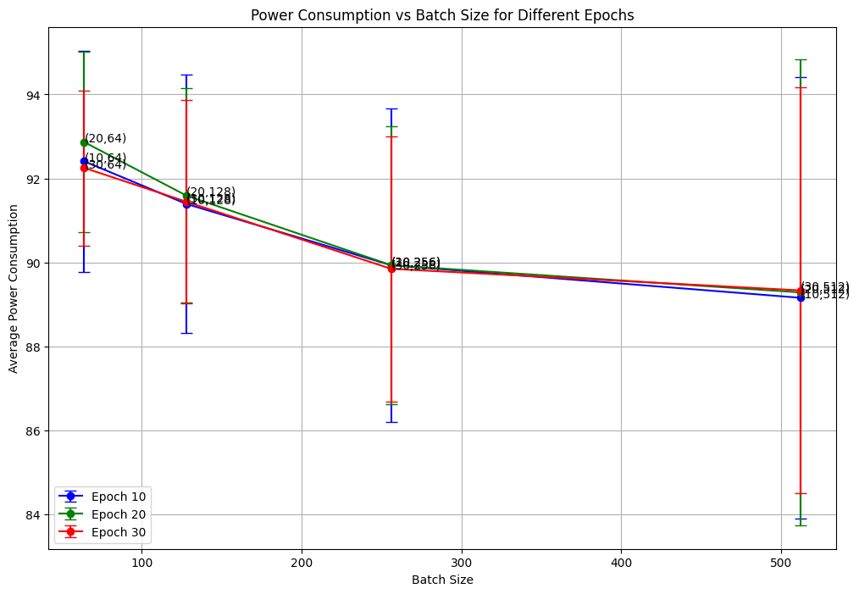
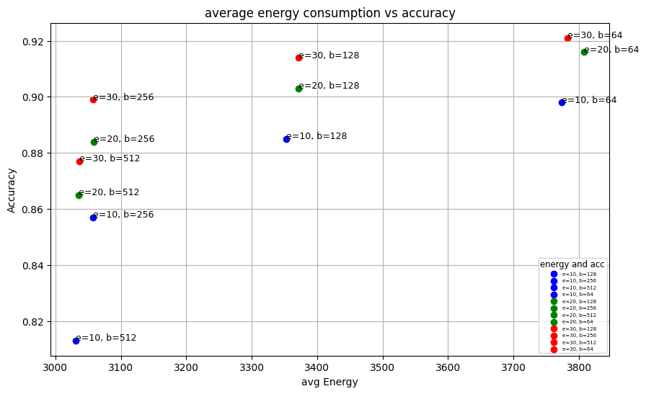
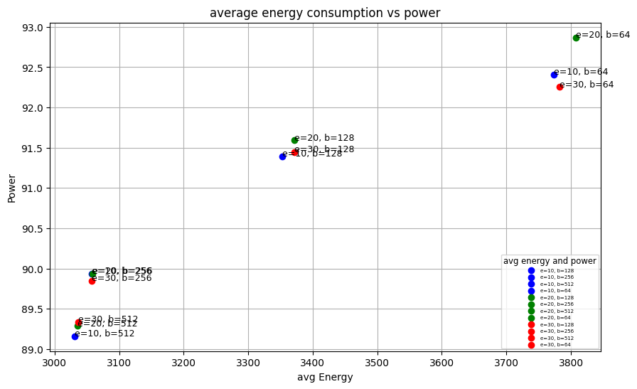
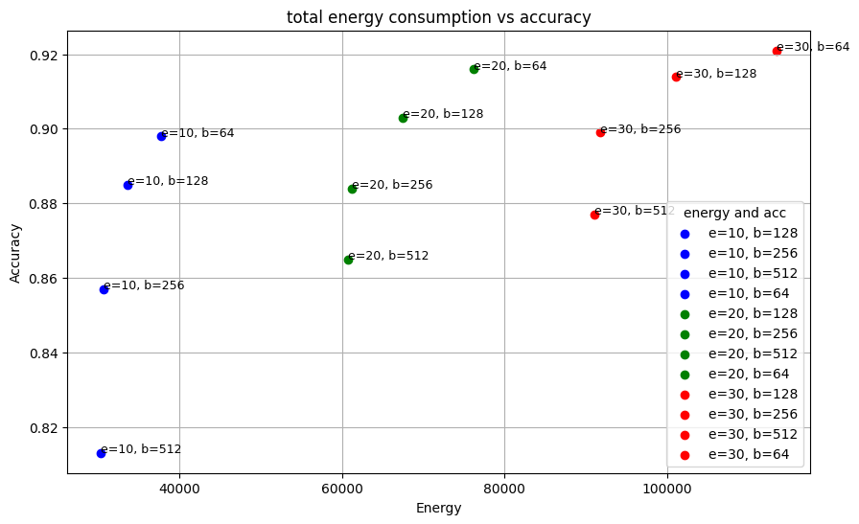
Energy consumption and acc
avg Power per second and std
avg energy per epoch and the acc
avg Power per second and avg energy per epoch
total energy per epoch and the acc
Dataset: Fashion_MNIST
Model: Alexnet
Device Max Power:95W
Notes:
调整模型，看看是否能到达相同的精确度
bigger dataset ， same acc
同样类型的图片（红黄绿）

Slide 20
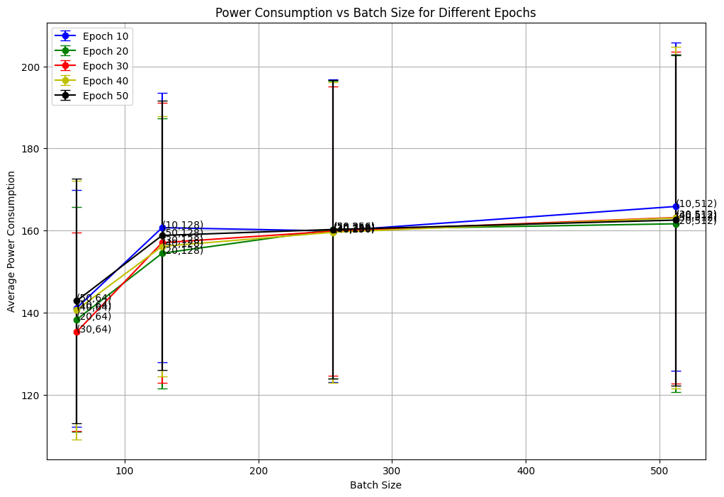
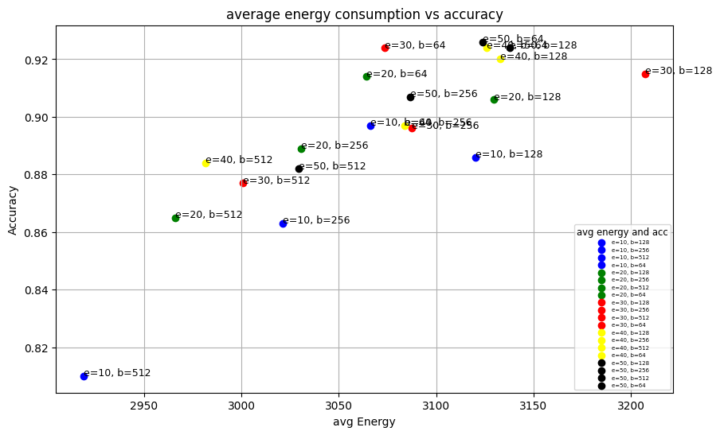
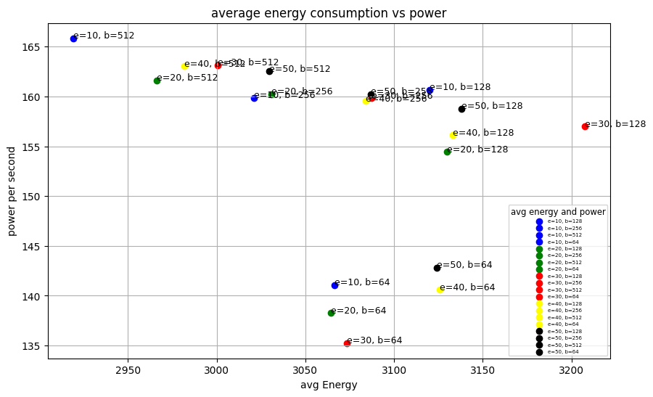
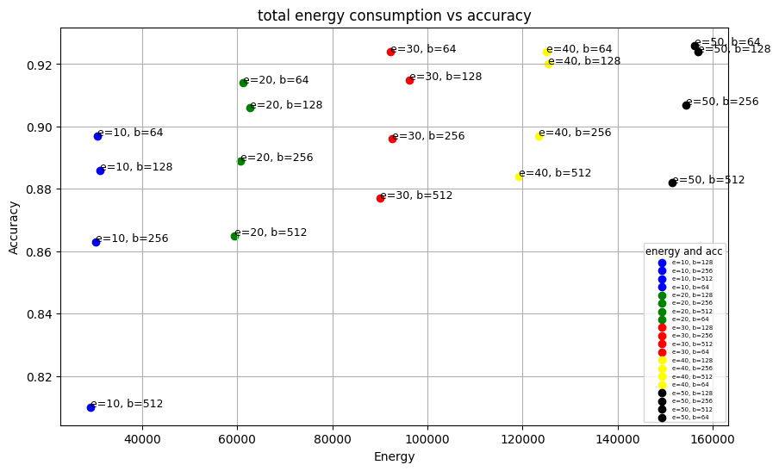
Energy consumption and acc
avg Power per second and std
avg energy per epoch and the acc
total energy and the acc
avg Power per second and avg energy per epoch
Dataset: Fashion_MNIST
Model: Alexnet
Device Max Power:450W
Notes:
调整模型，看看是否能到达相同的精确度
bigger dataset ， same acc
同样类型的图片（红黄绿）

Slide 21



Energy consumption and acc
avg energy per epoch and the acc
total energy and the acc
avg Power per second and avg energy per epoch
Dataset: CIFAR100
Model: Alexnet
Device Max Power:450W
Notes:
调整模型，看看是否能到达相同的精确度
bigger dataset ， same acc
同样类型的图片（红黄绿）

Slide 22




Different Power limit performance
avg running time and avg energy consumption of each epoch
avg running time and avg energy consumption of each epoch
Total energy consumption and acc under different power limit
Dataset: Fashion_MNIST
Model: Alexnet
Device Max Power:95W
Epoch=10, batchsize=128
Total energy consumption and acc under different power limit
Dataset:CIFAR100
Model: Alexnet
Device Max Power:95W
Epoch=5, batchsize=128
Notes:
调整模型，看看是否能到达相同的精确度
bigger dataset ， same acc
同样类型的图片（红黄绿）

Slide 23











last week unsolved problem
Distribution of the avg power in each epoch in different epoch & batchsize combination
Epoch: 10
Epoch: 20
Epoch: 30
Epoch: 40
Dataset: Fashion_MNIST
Model: Alexnet
Epoch: 50

Slide 24













last week unsolved problem
Distribution of the avg power in each epoch in different epoch & batchsize combination
Epoch: 10
Epoch: 20
Epoch: 30
Epoch: 40
Dataset: CIFAR100
Model: Alexnet
Epoch: 50
Epoch: 80

Slide 25






Energy dispatch
-
Storage Battery
+
+
+
Data Center
Model training request
Solar Panels
Power Grid

Slide 26



Energy dispatch
Training process
Objective function
$$min\sum_{t=1}^{T}{C_{t}}$$
$C_{t}$ ($€$): electricity cost of each time slot by data center
Cost function
$$C_{t}=G_{t}^{solar}∙∆T∙Q_{t}^{solar}+G_{t}^{grid}∙∆T∙Q_{t}^{grid}−W_{t}∙∆T∙Q_{t}^{grid′}$$
avg GPU power / W | 100 | 125 | 150 | 175 | 200 | 225 | 250
Training time / s (approximate) | 60000 | 50000 | 46000 | 45000 | 44000 | 42000 | 40000
$G_{t}^{solar}$ ($W$): power generated by solar panels
$Q_{t}^{solar}$ ($€/kWh$) : unit price generated by solar panels
$G_{t}^{grid}$($W$): power generated by grid
$Q_{t}^{grid}$ ($€/kWh$) : unit price generated by grid
$W_{t}$ ($W$): power sold back to grid
$Q_{t}^{grid′}$ ($€/kWh$) : unit price of sold back to grid
$∆T$ = 1 hour
100h
66.6h
You, Jie, Jae-Won Chung, and Mosharaf Chowdhury. "Zeus: Understanding and optimizing {GPU} energy consumption of {DNN} training." In 20th USENIX Symposium on Networked Systems Design and Implementation (NSDI 23), pp. 119-139. 2023.
Notes:
暂时先不考虑太阳能的部分
用最优的方案，看看能剩多少钱，比较两种极端情况，计算最终能够节省下来的钱有多少能够用到安装太阳能电池板上
注意一下如果按照这个数据来进行计算的话要考虑开始时间，早上的话太阳能多，晚上的话太阳能少但是电价便宜

Slide 27












Energy dispatch
s.t. :
Solar panels
Data center
$$\left\{\begin{aligned}0≤G_{t}^{solar}≤G_{max}^{solar} \\ G_{t}^{solar}=P_{t}^{solar}+R_{t}^{solar}+W_{t}^{solar}\end{aligned}\right.$$
$P_{t}=P_{t}^{solar}+P_{t}^{grid}$ + ${βD}_{t}^{dc}$
$P_{t}$ = $\left[100, 125 …250\right]$
$P_{t}^{solar}$ ($W$): power to supply the data center
$R_{t}^{solar}$ ($W$): power to restore to the battery
$W_{t}^{solar}$ ($W$): power sold back to grid
Charge ESD
$$R_{t}=R_{t}^{solar}+R_{t}^{grid}$$
Grid
$$\left\{\begin{aligned}0≤G_{t}^{grid}≤G_{max}^{grid} \\ G_{t}^{grid}=P_{t}^{grid}+R_{t}^{grid}\end{aligned}\right.$$
Back to grid
$$W_{t}=W_{t}^{solar}+{βD}_{t}^{grid}$$
$P_{t}^{grid}$ ($W$): power to supply the data center
$R_{t}^{grid}$ ($W$): power to restore to the battery
ESD power in each time slot
ESD (energy storage device)
$$E_{t}=(1−θ)∙\left[E_{t−1}−D_{t−1}^{dc}−D_{t−1}^{grid}+αR_{t−1}\right]$$
$E_{1}=0,D_{1}^{dc}=0,D_{1}^{grid}$=0
Charge efficiency $α$ : 85% ~ 95%
Discharge efficiency $β$ : 85% ~ 95%
Self discharge efficiency $θ$: 0.1% ~ 0.3%
Charge to data center: $D_{t}^{dc}$
Charge to grid: $D_{t}^{grid}$
$$\left\{\begin{aligned}0≤E_{t}≤E_{max} \\ {0≤D}_{t}^{dc}+D_{t}^{grid}≤E_{t} \\ {0≤R}_{t} ≤E_{max}−E_{t}\end{aligned}\right.$$

Slide 28
$${βD}_{t}^{dc}$$
$$R_{t}^{solar}$$
$$P_{t}^{solar}$$
+
Data Center
$$W_{t}^{solar}$$
Max. GPU power P(w) | 100 | 125 | 150 | 175 | 200 | 225 | 250
Appr. training time T(h) | 16 | 14 | 13 | 12.5 | 12 | 11.5 | 11
Rate | $$\frac{1}{16}$$ | $$\frac{1}{14}$$ | $$\frac{1}{13}$$ | $$\frac{1}{12.5}$$ | $$\frac{1}{12}$$ | $$\frac{1}{11.5}$$ | $$\frac{1}{11}$$
$$P_{t}^{grid}$$
$$R_{t}^{grid}$$
$${βD}_{t}^{grid}$$
Model training request [1]
Power supply

Slide 29







$${βD}_{t}^{dc}$$
Max. GPU power P(w) | 100 | 125 | 150 | 175 | 200 | 225 | 250
Appr. training time T(h) | 16 | 14 | 13 | 12.5 | 12 | 11.5 | 11
Appr. training time T(h) | 32 | 28 | 26 | 25 | 24 | 23 | 22
$$R_{t}^{solar}$$
$$P_{t}^{solar}$$
+
Data Center
$$W_{t}^{solar}$$
Model training request
$$P_{t}^{grid}$$
$$R_{t}^{grid}$$
$${βD}_{t}^{grid}$$
Power supply

Slide 30


Energy dispatch
Objective function
$$min\sum_{t=1}^{T}{C_{t}}$$
$C_{t}$ ($€$): electricity cost of each time slot by data center
Cost function
$$C_{t}=G_{t}^{solar}∙∆T∙Q_{t}^{solar}+G_{t}^{grid}∙∆T∙Q_{t}^{grid}−W_{t}∙∆T∙Q_{t}^{grid′}$$
$G_{t}^{solar}$ ($W$): power generated by solar panels
$Q_{t}^{solar}$ ($€/kWh$) : unit price generated by solar panels
$G_{t}^{grid}$($W$): power generated by grid
$Q_{t}^{grid}$ ($€/kWh$) : unit price generated by grid
$W_{t}$ ($W$): power sold back to grid
$Q_{t}^{grid′}$ ($€/kWh$) : unit price of sold back to grid
$∆T$ = 1 hour
Notes:
暂时先不考虑太阳能的部分
用最优的方案，看看能剩多少钱，比较两种极端情况，计算最终能够节省下来的钱有多少能够用到安装太阳能电池板上
注意一下如果按照这个数据来进行计算的话要考虑开始时间，早上的话太阳能多，晚上的话太阳能少但是电价便宜

Slide 31






Energy dispatch
s.t. :
Solar panels
Data center
$$\left\{\begin{aligned}0≤G_{t}^{solar}≤G_{max}^{solar} \\ G_{t}^{solar}=P_{t}^{solar}+R_{t}^{solar}+W_{t}^{solar}\end{aligned}\right.$$
$P_{t}=P_{t}^{solar}+P_{t}^{grid}$ + ${βD}_{t}^{dc}$
$$\sum_{t=1}^{T}{\frac{1}{J_{t}}}≥1$$
$P_{t}^{solar}$ ($W$): power to supply the data center
$R_{t}^{solar}$ ($W$): power to restore to the battery
$W_{t}^{solar}$ ($W$): power sold back to grid
$P_{t}$ ($W$): supplied power to data center [100, 125, 150, 175, 200, 225, 250]
$J_{t}$ ($h$): training time [16, 14, 13, 12.5, 12, 11.5, 11]
Grid
$$\left\{\begin{aligned}0≤G_{t}^{grid}≤G_{max}^{grid} \\ G_{t}^{grid}=P_{t}^{grid}+R_{t}^{grid}\end{aligned}\right.$$
Charge ESD
$$R_{t}=R_{t}^{solar}+R_{t}^{grid}$$
$P_{t}^{grid}$ ($W$): power to supply the data center
$R_{t}^{grid}$ ($W$): power to restore to the battery
Back to grid
$$W_{t}=W_{t}^{solar}+{βD}_{t}^{grid}$$
ESD (energy storage device)
ESD power in each time slot
Charge efficiency $α$ : 85% ~ 95%
Discharge efficiency $β$ : 85% ~ 95%
Self discharge efficiency $θ$: 0.1% ~ 0.3%
Charge to data center: $D_{t}^{dc}$
Charge to grid: $D_{t}^{grid}$
$$E_{t}=(1−θ)∙\left[E_{t−1}−D_{t−1}^{dc}−D_{t−1}^{grid}+αR_{t−1}\right]$$
$E_{1}=0,D_{1}^{dc}=0,D_{1}^{grid}$=0
$$\left\{\begin{aligned}0≤E_{t}≤E_{max} \\ {0≤D}_{t}^{dc}+D_{t}^{grid}≤E_{t} \\ {0≤R}_{t} ≤E_{max}−E_{t}\end{aligned}\right.$$

Slide 32

Energy dispatch – case study
Notes:
考虑多个情况：
1.全功率运行的情况
2.启动时间
3.整理，并且开始写论文

Slide 33







Simulation results with ResNet
Batch_size:256
Epoch:50
Dataset: Fashion_MNIST
Notes:
调整模型，看看是否能到达相同的精确度
bigger dataset ， same acc
同样类型的图片（红黄绿）

Slide 34







Simulation results with ResNet
Batch_size:256
Epoch:40
Dataset: CIFAR100
Notes:
用这个能耗来带入epoch300那个，来估算

Slide 35


Simulation results with ResNet
https://pytorch.org/vision/stable/models.html
Notes:
调整模型，看看是否能到达相同的精确度
bigger dataset ， same acc
同样类型的图片（红黄绿）

Slide 36




Simulation results with GoogleNet
Notes:
调整模型，看看是否能到达相同的精确度
bigger dataset ， same acc
同样类型的图片（红黄绿）

Slide 37




Simulation results with GoogleNet
6.75
2.8
4708.29
4044.53
3582.59
7.86
2930.7
2.95
9.23
3.41
5.39
2.71
Notes:
调整模型，看看是否能到达相同的精确度
bigger dataset ， same acc
同样类型的图片（红黄绿）

Slide 38
Simulation results with GoogleNet
GPU calculation capacity(Theory)
Total MACs per second=CUDA cores * Frequency (Hz)*MACs per cycle per core * GPU Utilization
Frequency (Hz) during training: 2700MHz
CUDA cores: 16384(RTX4090)
GPU Utilization: 90%
Effective MACs per second: 3.981*10e12 per second
FashionMNIST picture in GoogleNet:
Model MACs: 1.52*10e9
Train Dataset: 60000
Total MACs: 9.12*10e13
Total forward time(Theory):
Time = Total MACs / Effective MACs per second = 2.29s
Actual Value: 9.8s

Slide 39






Simulation results with All
Notes:
explaination is important

Slide 40




Simulation results with All
Set all the VGG model as test datasets
Take one VGG model as train datasets and others as test datasets

Slide 41



Energy dispatch – case study
1. Parameters setting
Tariff | Time slot | $Q_{t}^{grid}$ $€/kWh$
F1 | 08:00 – 20:00 | 0.45
F2 | 20:00 – 23:00 | 0.35
F3 | 23:00 – 08:00 | 0.25
Max. GPU power P(w) | 100 | 125 | 150 | 175 | 200 | 225 | 250
Appr. training time T(h) | 32 | 28 | 26 | 25 | 24 | 23 | 22
 | Charge efficiency $α$ | Discharge efficiency $β$ | Self discharge efficiency $θ$
ESD | 0.9 | 0.9 | 0.005
$$Q_{t}^{grid^{′}}=0.3€/kWh$$
2. Simulations setting
Set the start time of the training process from 0 to 143 hours.
Set the duration of the training process from 23 to 32 hours.
Notes:
暂时先不考虑太阳能的部分
用最优的方案，看看能剩多少钱，比较两种极端情况，计算最终能够节省下来的钱有多少能够用到安装太阳能电池板上
注意一下如果按照这个数据来进行计算的话要考虑开始时间，早上的话太阳能多，晚上的话太阳能少但是电价便宜

Slide 42



Energy dispatch – case study
PV_solar power at different time
If start training the model when the PV panels are just starting to generate electricity, the electricity cost will be the lowest.
Minimum cost under different start time
Notes:
暂时先不考虑太阳能的部分
用最优的方案，看看能剩多少钱，比较两种极端情况，计算最终能够节省下来的钱有多少能够用到安装太阳能电池板上
注意一下如果按照这个数据来进行计算的话要考虑开始时间，早上的话太阳能多，晚上的话太阳能少但是电价便宜

Slide 43






Energy dispatch – case study
Set the duration of the training process from 23 to 32 hours. The shorter the training time, the higher the cost.
Notes:
如果不卖电回去的话，看看结果
task is the priority, case that hour by hour that how much it storage and supply the data center

Slide 44





Data center running at max power all the time
Start time at 3
Start time at 9
Start time at 15
Start time at 21
Start time at 27
Notes:
add the money of the cost

Slide 45
Structure of Thesis
Energy consumption monitor tools(codecarbon/nvidia-smi)
Model energy consumption on different hardwares
Different model energy consumption capture
Relationship between different setting(epoch, batch size and dataset)
Considering the model accuracy with different setting(model, epoch number)
Relationship between energy consumption and model
Training speed relationship with different frequency and voltage in hardware

Slide 46
Thanks

